Slide 1
Capstone 2
Hotel Reviews

Slide 2
Data Set
Taken from Kaggle
3 Tables

Slide 3
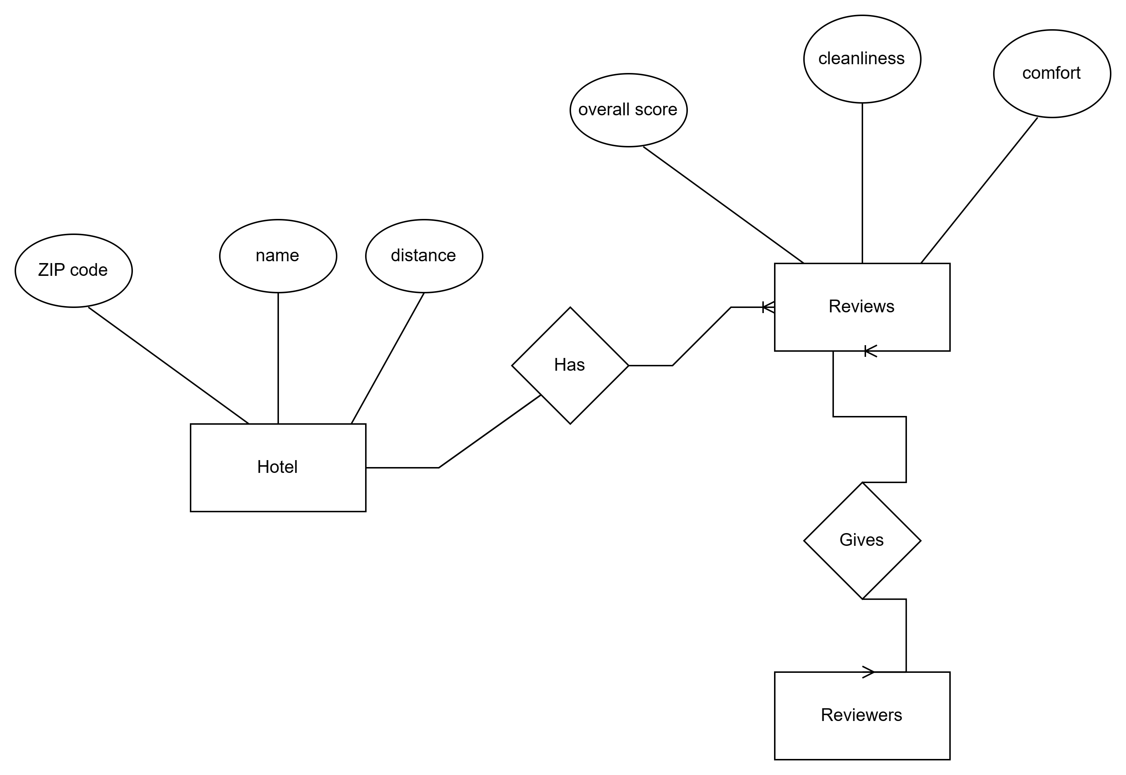
Entity Diagram

Slide 4
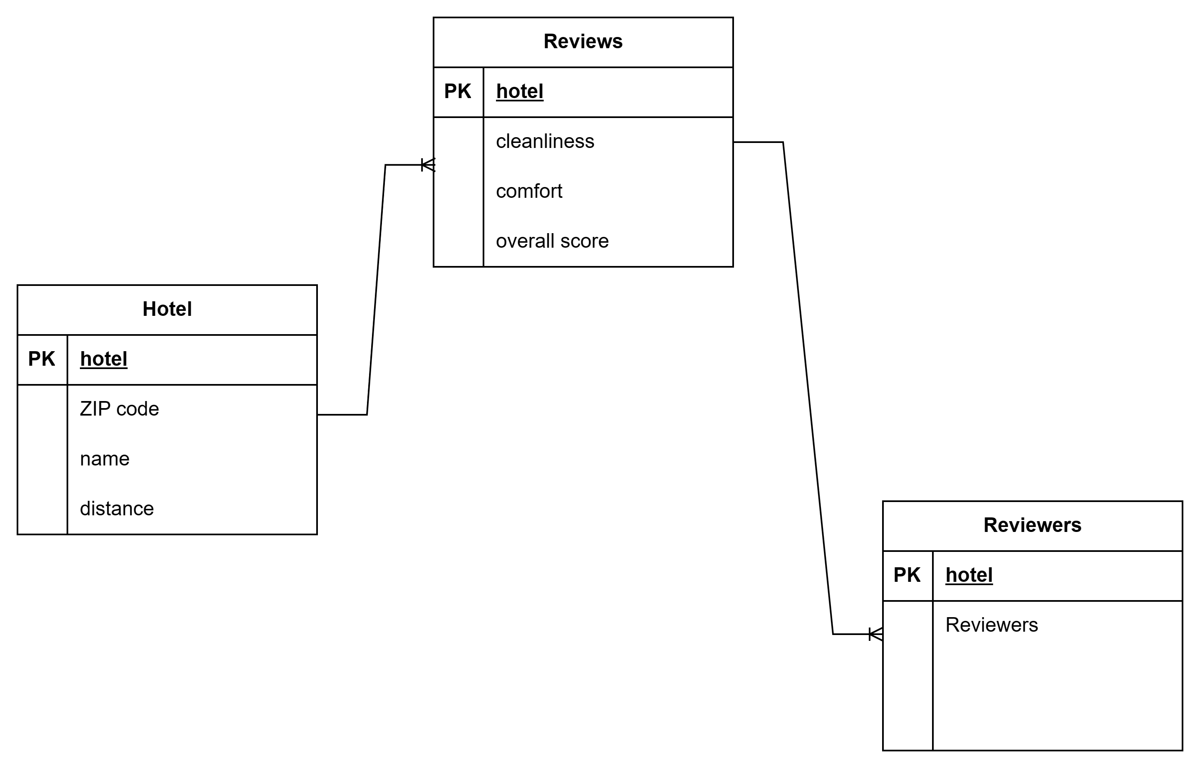
Schema

Slide 5
Data Cleaning
Remove blank spaces
Syntax –
select * from hotel
where "Cleanliness" != '';
DROP TABLE IF EXISTS hotel_cleaned;
CREATE TABLE hotel_cleaned AS
select * from hotel where "Cleanliness" != '';
DROP TABLE IF EXISTS hotel_cleaned;
CREATE TABLE hotel_cleaned AS
select * from hotel
where "Cleanliness" != '';
select * from hotel_cleaned;

Slide 6
Data Cleaning
Remove all commas from "Number of reviewers“
UPDATE hotel_cleaned
SET
"Number of reviewers" =
replace(hotel_cleaned."Number of reviewers",',','');

Slide 7
Data Cleaning
Alter column TYPE from str to int
Alter table hotel_cleaned alter column "Number of reviewers"
set data type int USING "Number of reviewers"::integer;

Slide 8
Zip Table
Syntax
CREATE TABLE zip AS SELECT DISTINCT "Zip code" FROM hotel_cleaned;
ALTER TABLE zip ADD COLUMN zip_id serial primary key;
select * from zip;
ALTER TABLE hotel_cleaned ADD column zip_id int;
UPDATE hotel_cleaned SET zip_id = zip.zip_id FROM zip WHERE hotel_cleaned."Zip code" = zip."Zip code";
Alter TABLE hotel_cleaned DROP COLUMN "Zip code";
select * from hotel_cleaned;

Slide 9
Query( Most reviewed hotels)
select "Number of reviewers" from hotel_cleaned;
select "Number of reviewers", zip."Zip code"
from hotel_cleaned inner join zip
on hotel_cleaned.zip_id = zip.zip_id
order by "Number of reviewers" desc
LIMIT 5;
Number of reviewers | Zip code
5880 | 90045
5663 | 90045
4050 | 90304
4039 | 90045
4004 | 90045

Slide 10
Query(Top reviews)
select "Overall score" from hotel_cleaned;
select "Overall score", zip."Zip code"
from hotel_cleaned inner join zip on hotel_cleaned.zip_id = zip.zip_id
order by "Overall score" desc;
Overall score | Zip code
9.9 | 90046
9.8 | 91604
9.8 | 90036
9.8 | 90036
9.8 | 90024

Slide 11
Best reviewed hotel
Palihotel Melrose | 90046
WeHo Bungalow with Private Garden | 90046
Luxury Suite in The Heart of Hollywood | 90046
Dresden B & B | 90046
West Hollywood Guesthouse | 90046
SureStay Collection by Best Western Saharan Hotel | 90046
The Moment Hotel | 90046
Elaine's Hollywood Bed & Breakfast | 90046
Sunset Strip 1-Bedroom with Balcony, Pool and Views | 90046
Chic and Charming 1 bdr | 90046
Chateau Marmont | 90046
WeHo Palace, 2 Bedroom 2 Full Bath | 90046
Hollywood Bed & Breakfast | 90046
Prime West Hollywood, Gorgeous & Renovated 2 Bed 2 Bath | 90046

Slide 12
Best Hotel
select * from hotel_cleaned order by "Overall score" desc limit 1;
name | Number of reviewers | Overall score | Dist | zip_id
Sunset Strip 1-Bedroom with Balcony, Pool and Views | 6 | 9.9 | (7.5 miles from center) | 42

